Slide 1
A Lifetime Lesson
Read this story well and Read this story and If the conclusion is correct and I like to think it is, do not hesitate to do something. ...

Slide 2
Yes, this is a great lifetime lesson. Something to think about…

Slide 3
Qian Hongyan lost both legs in an accident.
Her Chinese family is very poor and can not afford prosthesis for her. So, she uses a basketball to move from place to place.

Slide 4
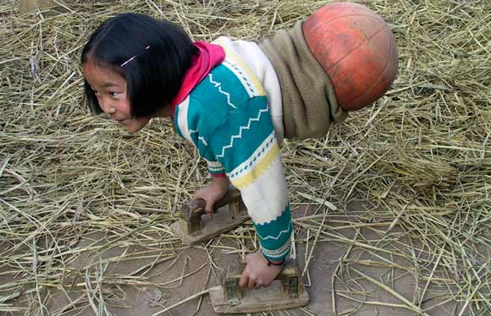
Qian uses two wooden supports. She never complains. She has already used six basket balls.

Slide 5
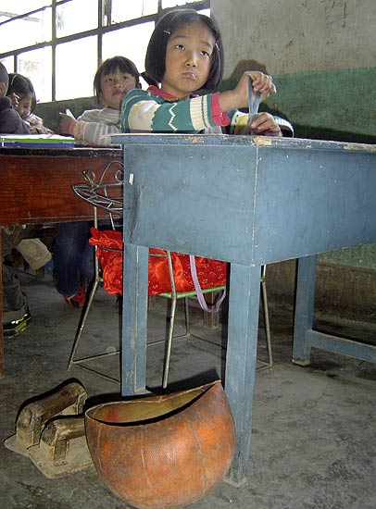
She goes to school…

Slide 6
Always Smiling….

Slide 7
Always Positive…

Slide 8
With few key stokes on your computer, she may have a pair of legs.

Slide 9
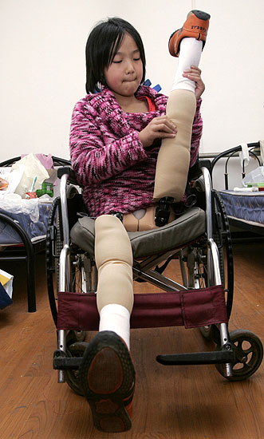
Two Prosthesis….

Slide 10
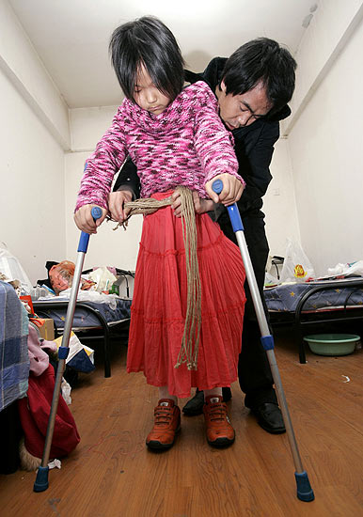

Slide 11
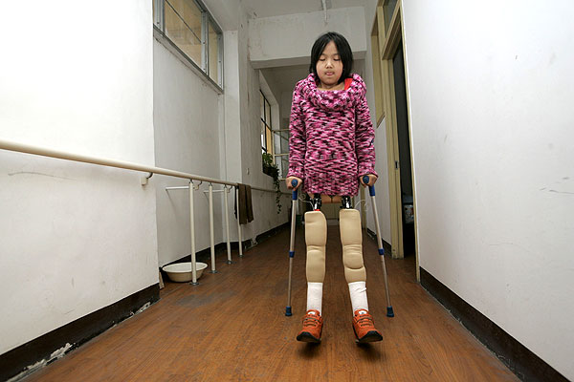
If you forward this presentation to your friends, AOL will pay 10 cents for each email you send.

Slide 12
Now you have two options: delete this presentation or forwaed it to all your friends.
I hope you do the latter and forward to all your friends.
Thank you!!
END

